Slide 1

Speak Fluently & Confidently B1- Course 1

Slide 2
Session 5- Talking about Travelling (i)
Part 1-: At a Hotel (Listening)
Part 2: What would you say in the following
situations? ( Idioms & collocations)
Part 3: Speaking Practice
https://befluent.me/

Slide 3
Session 5- Talking about Travelling
Part 1-: At a Hotel
( Listening )
https://befluent.me/

Slide 4
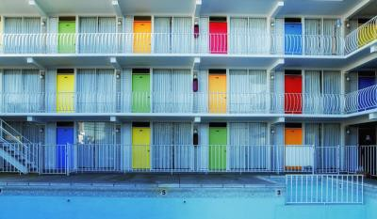
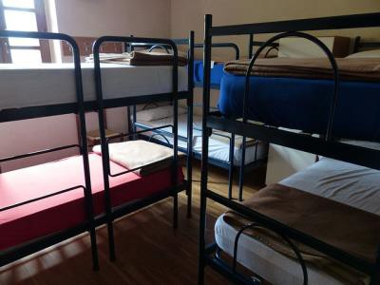
Lesson 5 – At a Hotel
Welcome to Lesson 5 of the Everyday English Speaking Course! Today you’re going to learn how to make a hotel reservation, check in and check out, and describe problems with your hotel room.
First let’s learn about a few different types of hotels:
A motel is a very simple, very basic hotel – usually located by the side of a road, for people to stop and stay for one night while driving long distances.
Motels often have outside doors to the rooms.
A hostel is a place where you can stay in a large dormitory room with other people. Everyone shares the bathroom and kitchen. Hostels are popular with backpackers and young travelers.

Slide 5
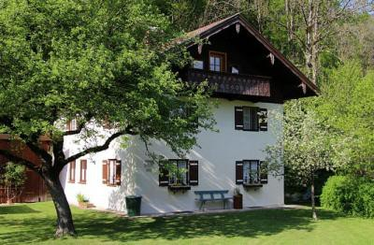
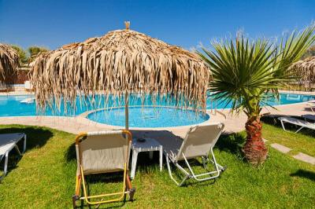
A bed and breakfast is a private house, usually with fewer than 10 rooms available, where a family lives in the house and rents out the rooms.
A resort is usually the most expensive type of hotel, because it includes very complete facilities – food and drink, swimming pools, sports and fitness centers, spas, entertainment, and shopping.
Conversation #1 – Making a reservation
Receptionist: Good evening, Florence Hotel.
Henry: Hi, I’d like to book a double room for this weekend. What are your rates?
Receptionist: Would you like a standard room or a suite? The standard room is
$145 per night and the suites are $200.
(suites are bigger, more expensive and more comfortable than standard rooms)

Slide 6
Henry: A standard room, please. Does that include breakfast?
Receptionist: Yes, it does. Will that be two twin beds or one double bed?
(Twin bed = a bed for one person.
Double bed / Queen-sized bed / King-sized bed = a bed for two people)
Henry: One double bed.
Receptionist: And when will you be arriving?
Henry: We’ll be coming on April 12th and leaving on the 15th. By the way, does the room have WiFi?
Receptionist: No, only in the lobby.
Henry: Oh… I guess that’s all right. Receptionist: Okay. Can I get your name, please?
Conversation Vocabulary & Phrases
Henry starts the conversation by saying “I’d like to book a room…” To “book” a room means to reserve and pay for a room. You can also use the verb “book” with flights. Here are some other ways to begin making a hotel reservation:
“I’d like to make a reservation for 3 nights.”
“Do you have any rooms available for October 24th?”
To ask about how much it costs, you can say:
“How much is it per night?”
“What’s the price per night?”
“What are your rates?”
“Does that include breakfast?”
“Is breakfast included?”
Henry asks if the room has WiFi (wireless internet). Here are some other questions about the hotel facilities or things in the room:

Slide 7
“Does the room have…
air-conditioning?
a ceiling fan?
a view?
a bathtub?
a balcony?
“Does the hotel have…
laundry facilities?
a swimming pool?
a fitness center?
a business center?
Conversation #2 – Checking in
When you arrive at the hotel, you will enter the lobby (the reception area) and go to the front desk (the place where the receptionist works)
Receptionist: Hello, how can I help you?
Henry: Hi, I have a reservation under the name “Henry McAllister.”
Receptionist: Just a moment, I’ll look it up… ah, here it is – a standard double room for three nights. Can you fill out this form, please?
Henry: Sure.
Receptionist: OK, Mr. and Mrs. McAllister, here are your key cards. You’re in room 327 on the third floor. Breakfast is served from 7 to 10, and the elevators are right over there.
Henry: Thanks. One question – what time is check-out?
Receptionist: Check-out is at 11:30.

Slide 8
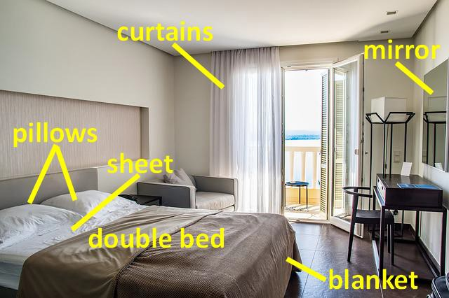
Conversation Vocabulary & Phrases
Henry asks the receptionist, “What time is check-out?” – he is asking what time it is necessary to leave the hotel room at the end of his stay. Here are some other questions you can ask the receptionist when you arrive at a hotel:
“What time is breakfast?”
“What are the hours for the…
o fitness center / swimming pool / restaurant / bar?”
“What’s the WiFi password?”
“Could I have a wake-up call tomorrow morning at 6?”
“Where can I park my car?”
Hotel Room Vocabulary
Here are a few things you might find in your hotel room. Listen to the words and practice your pronunciation.

Slide 9
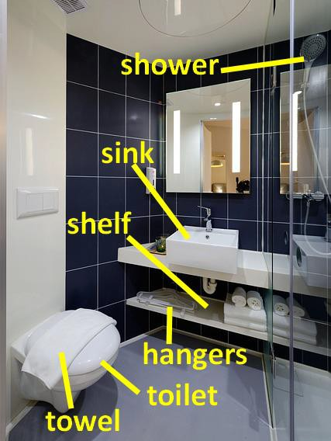
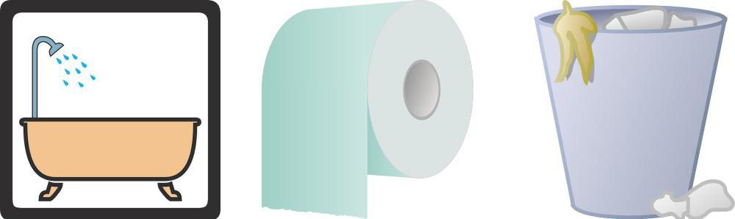
bathtub
toilet paper
trash can / garbage can
Conversation #3 – Reporting Problems with the Room
Henry and his wife go up to their hotel room, but they discover a few minor problems – so they call the front desk to ask for help.
Receptionist: Front desk – this is Julia.

Slide 10
Henry: Hi – there’s a problem with my room. The fan isn’t working.
Receptionist: I’ll send somebody up to fix it right away. Henry: Oh, and also there’s no shampoo.
Receptionist: You can come get some at the front desk. Is there anything else?
Henry: Yes, can I have some extra pillows?
Receptionist: Of course – we’ll bring them to your room.
Henry: Thanks a lot.
Conversation Vocabulary & Phrases
If something is not functioning correctly, you can say it’s not working, for example:
“The TV’s not working.”
“The shower’s not working.”
“My keycard’s not working.”
If something is not present in your room, you can say there’s / there are no…
“There’s no toilet paper.”
“There’s no shampoo / soap.”
“There’s no hot water.”
“There are no towels / sheets.”
Here are some other possible problems with hotel rooms:
“The sheets are stained.”
“The toilet doesn’t flush.”
“The room’s too hot / cold / noisy.”
“The room hasn’t been cleaned.”
“The room smells bad.”
“Can I have a different room, please?”

Slide 11
Conversation #4 – Checking out
When you leave the hotel, you need to give your key (or key card) back to the receptionist, and pay any remaining charges for your stay. This process is called check-out.
Henry: Good morning – I’m checking out.
Receptionist: Okay, I’ll just need your room key, please. How was your stay? Henry: It was great – no complaints here.
Receptionist: Wonderful! Did you have anything from the mini-bar?
Henry: Yes – one bottle of water and one orange juice.
Receptionist: All right… your bill comes to $15.50. Henry: What’s this $10 charge for?
Receptionist: That’s for the phone calls you made from your room.
Henry: Oh, okay.
Receptionist: Would you like to put this on your credit card?
Henry: No, I’ll pay cash. How can I get to the airport from here? Receptionist: You can take the free shuttle bus, or I can call a cab for you.
shuttle bus = a bus that travels between two places only (and does not have multiple stops)
cab = taxi
Henry: What time is the next bus?
Receptionist: 10:30.

Slide 12
Henry: Will it get to the airport before noon? My flight’s at 2:15.
Receptionist: Oh, definitely.
Henry: All right – I’ll take the bus, then.
Conversation Vocabulary & Phrases
You can start by saying “I’m checking out.” or “I’d like to check out.” If you enjoyed your time at the hotel, you can say:
“I enjoyed my stay.”
“Everything was great.”
“No complaints here.”
If you want to talk about some problems you had with the hotel or room, you can say “I have a few complaints…” and then explain the negative experiences.
To ask about transportation from the hotel to the airport, you can say:
“How can I get to the airport from here?”
“Does the hotel have a shuttle bus to the airport?”
“Could you call a taxi/cab for me?”
Sometimes you need to check out of a hotel in the morning, but your flight is in the late afternoon or evening – so you want to spend a little more time in the city, but you don’t want to carry all your luggage around. In this case, you can say:
“My flight isn’t until 8:00. Could I leave my bags here at reception and pick them up later?”
You’ve finished Lesson 18! Now try the quiz to test your memory of the key phrases. In tomorrow’s lesson, you’ll learn about sightseeing – how to see the tourist spots in a city.

Slide 13
Quiz – Lesson 5
I'd like to a room.
date
book
request
How is it per night?
much
cost
many
I have a under the name "Janet Allen."
request
reserve
reservation
We'll be for five nights.
sleeping
renting
staying
Is breakfast ?
paid
included
inside
What time is ?
check-off
check-up
check-out
Can I another blanket?
bring
have
take

Slide 14
Does the hotel WiFi?
has
had
have
the room have air-conditioning?
Is
Does
Do
"Was everything OK?" "No here."
complaints
errors
negatives
The remote control's working.
doesn't
hasn't
not
"What's this extra $25 on my bill for?"
cash
change
charge
" no hot water in the bathroom."
Has
Is
There's
"How can I to the airport from here?"
get
leave
arrive

Slide 15
Do you have any _ available for tonight?
luxuries
resorts
suites

Slide 16
Lesson 5 Quiz - Answers
1.B 2.A 3.C 4.C 5.B 6.C 7.B 8.C 9.B 10.A 11.C 12.C 13.C 14.A 15.C

Slide 17
Session 5- Talking about Travelling
Part 2: What would you say in the following
situations? ( Idioms & collocations)
https://befluent.me/

Slide 18
Session 5- Talking about Travelling
A Desolate Area /ˈdes.Əl.Ət/
Meaning: could be part of a desert, a wasteland, or ghost town, etc
Example:
If you’re travelling or you’re going on a holiday, the last place you’d want to be is in a desolate area.
A Tedious Journey /ˈtiː.Di.Əs/
Meaning: boring, difficult, tiring, something that wears you out
Example:
Last Saturday, we travelled north out of the city, and the journey was tedious and slow as there was a lot of congestion.
A Panoramic View
Meaning: it spreads almost 360 degrees left to right, and you can span right across it
Example:
My hotel was situated in a lonely spot with a panoramic view of the countryside surrounding it.
Luxurious Accommodation /Lʌɡˈʒʊə.Ri.Əs/
Meaning: very comfortable and expensive
Example:
It was worth it. The accommodation was luxurious, and I would really suggest and recommend it to any of you to go in there.
https://befluent.me/

Slide 19
Session 5- Talking about Travelling
Poor Service
Meaning: low quality, not what you had expected, not up to scratch
Example:
We will never stay in this hotel again. The service was poor, the room was dirty, and the cost was way over-priced. Not what we had expected.
Far-Flung Location/Destination
Meaning: really far away, remote
Examples:
Our hotel was in a far-flung location, miles from the city. There was absolutely nothing around it.
As the world begins to open up after the pandemic, some of us have dared to dream about summer holidays in far-flung locations.
A Quaint Village /Kweɪnt/
Meaning: attractively unusual or old-fashioned
Example:
The quaint village of Cotswolds is nice to visit for Easter weekend.
mpeccable Service
Meaning: service that just cannot be criticised, cannot be bettered
Example:
They gave me a small bowl of fruit as an extra treat. What an impeccable service!
Unwary Traveller /Ʌnˈweə.Ri/
Meaning: innocent, not conscious of possible dangers and pitfalls
Example:
The unwary traveller walking along the beach needs to wear flip flops in case somebody’s left some broken glass.
https://befluent.me/

Slide 20
Session 5- Talking about Travelling
Part 3: Speaking Practice
https://befluent.me/

Slide 21
Session 5- Talking about Travelling
Which do you prefer to stay in when you travel: hotels, hostels, or another type of place? Why?
What are the best and worst things about staying in hotels?
Have you ever been to a really disgusting hotel? Did you stay or leave?
Couch surfing is staying for free at people’s homes in different countries. Is this a good idea or bad idea? Why?
Do you feel comfortable when you are staying at a hotel?
Have you ever ordered room service?
Do you have any interesting stories about staying somewhere other than your house, like a hotel or hostel?
Are hotels common in your country? If not, where do people stay when they travel?
What is the nicest hotel you have stayed at?
What would it be like to work in a hotel as a cleaning person or front desk staff?
Have you ever eaten anything out of the minibar (the refrigerator with snacks and drinks)? Was it expensive?
https://befluent.me/

Slide 22
Session 5- Talking about Travelling
Thank you!☺
https://befluent.me/

